Slide 1
Decision Making under Uncertainty: An Application in the Context of Competitive Pokémon Battles
29 January 2020
Zachary Silvis
MSSA SD7
Cloud Application Developer Learning Path

Slide 2
Table of Contents
Explanation of Competitive Pokémon Battles
Description of the Uncertainties Facing Pokémon Battlers
Theoretical Approach
Application Development
Phase 1
Phase 2
Phase 3
Data Sources
Conclusion

Slide 3

Explanation of Competitive Pokémon Battles
Each battle will begin with a 90-second Team Preview phase.
Each player submits a team of 6 Pokémon, from which 4 are brought into the battle
Two Pokémon are in play to start each game, with the remaining two in reserve
Each player selects a single action for each of his/her Pokémon currently on the field
All Pokémon will be set to Lv. 50, including Pokémon below Lv. 50
Unable to overwhelm an opponent via higher levels like in the standard game
Duplicate Pokémon not be allowed.
One of the primary constraints in the format, and therefore in my application
Duplicate held items will not be allowed.
Players will have 7 minutes of Your Time, 45 seconds of Move Time, and 15 minutes of Game Time in each battle.
Enforces time constraints as well as a knowledge constraint
A game match is over when one player either forfeits or all four of his/her Pokémon are defeated. The overall match is a best-out-of-three construct
Notes:
Sources:
https://www.Pokémon.com/us/Pokémon-news/2020-Pokémon-video-game-championships-vgc-format-rules/

Slide 4

Uncertainties Facing Pokémon Battlers
What 6 Pokémon should I select for my base team?
How do I evaluate whether one set of 6 Pokémon is better than another?
Which 4 Pokémon should I select to bring into battle, given the 6 Pokémon that my opponent has available?
Which two Pokémon should I sent into battle first, and which two should I hold in reserve initially?
What action should I select for each of my Pokémon (attack or switch position)?
What is my opponent most likely to do, given the information I have revealed to him/her?

Slide 5
Theoretical Approach
(Attack, Attack)
(Attack, Attack)
Probability and Statistics
Primarily conditional probability
Game Theory
Simultaneous games under complete, yet imperfect, information
Repeated games
Inspiration / Similarities to Chess and Poker
(Attack, Switch)
(Attack, Switch)
(Switch, Attack)
(Switch, Attack)
(Switch, Switch)
(Switch, Switch)
Notes:
Each player has a set of four unique combinations of actions each turn, for a total of 16 possible game states each turn. But because players select moves simultaneously, they don’t know what state of the game they are in until the turn plays out.

Slide 6
Application Development
Three development phases
Each will build on the previous phase
Will ensure the most basic / important functions are implemented first, and then add more complex nuances iteratively

Slide 7
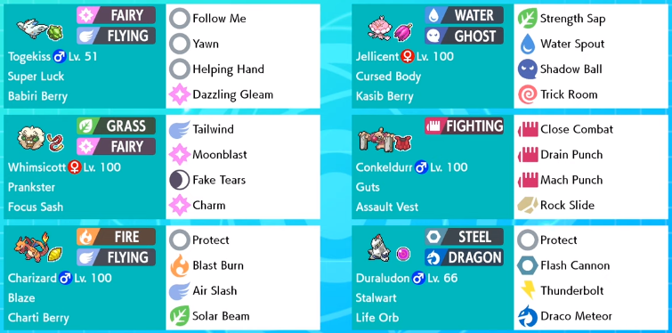



Application Development Phase 1: What is the Best Team?
Typing
Move set
Ability
Held Item
Factors Players Must Consider When Training Their Pokémon Team
Type | Stats | Ability | Moves | Held Items
18 total types Each Pokémon has 1 – 2 types Fire, Water, Grass, etc. | 6 stat categories: Hit Points Attack Defense Special Attack Special Defense Speed Each stat influenced by 3 different factors: Nature Individual Values Effort Values | Each Pokémon species can has 1 – 3 Abilities available Can only have one ability at a time Switching abilities is possible but costly / difficult | Each Pokémon has a unique move pool available to it Can only have 4 moves accessible in battle | Each Pokémon can hold a single item in battle Effects of items can range from reducing type-weaknesses to restoring health to increasing stats
Notes:
Team Building in Abstract
Which 6 Pokémon should a player select to form his/her base team?
How should those 6 Pokémon be evaluated individually? How should they be trained?
How should the team be evaluated as a collective entity?

Slide 8
Application Development Phase 1: What is the Best Team?
User-selected 6 Pokémon
Average Team Stat Rating
Team analysis Algorithm
System-selected 6 Pokémon (based on usage stats)
Overall Strengths / Weaknesses
(based on Types)

Slide 9
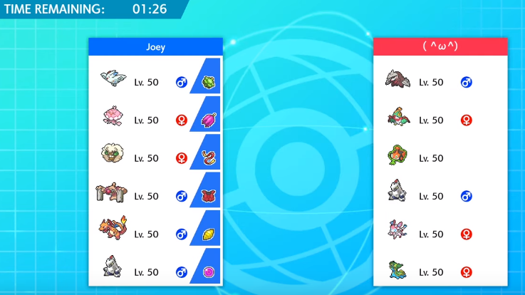
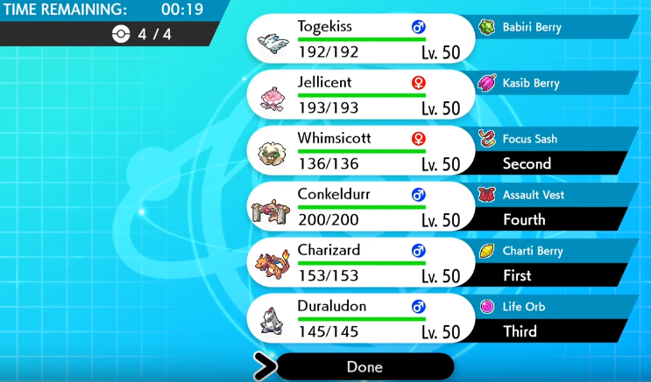
Application Development Phase 2: Which Pokémon to Bring into Battle?
Team Preview Screen
Team Selection Screen
Player’s Team
Opponent’s Team
The 1st and 2nd Pokémon are sent into battle first, and only four total are brought
Time Remaining to Make Selections
Notes:
Given the player’s 6-Pokémon team, which four Pokémon should the player select to bring into battle?
What four Pokémon would be strongest in the abstract?
More importantly, which four Pokémon would be the best option given the opponents set of 6 Pokémon, from which he/she is also selecting four Pokémon?
What are the most likely team combinations that a player is likely to face, given the current ruleset (“metagame”)?

Slide 10
Application Development Phase 2: Which Pokémon to Bring into Battle?
Opponent’s 6 Pokémon Team
Opponent’s Best 4 Pokémon Team
Predict Optimal Team Combination Algorithm
Player’s 6 Pokémon Team
Player’s Best 4 Pokémon Team

Slide 11
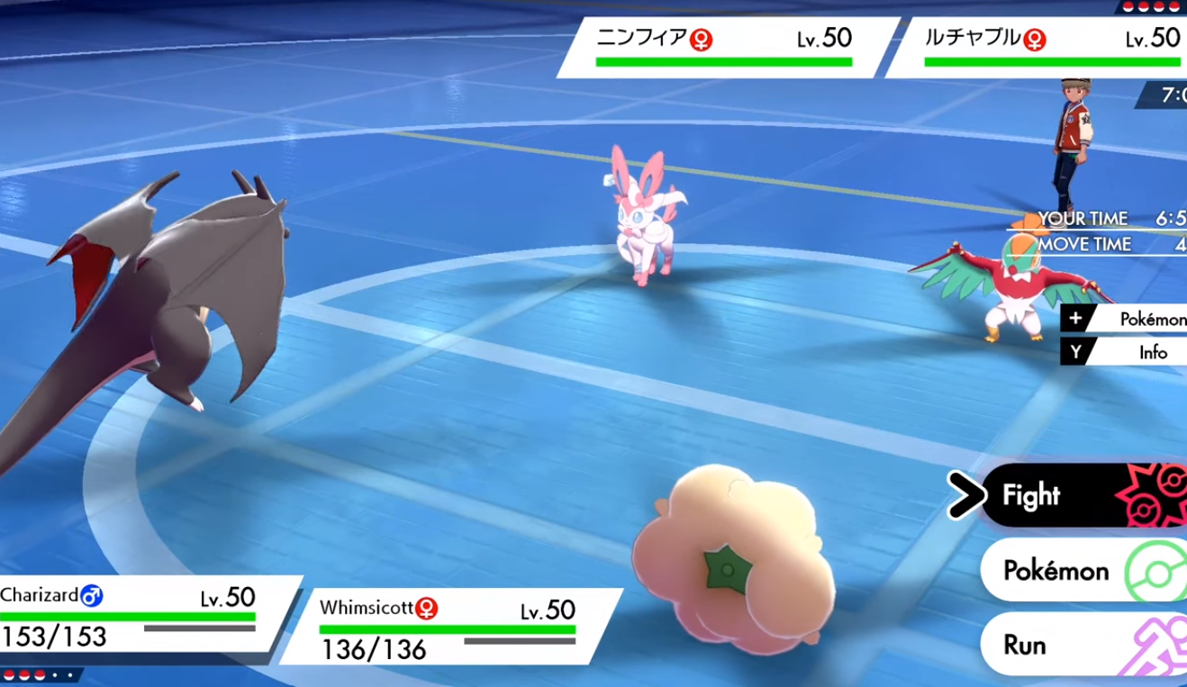
Application Development Phase 3: What Tactics To Employ, Given Each Player’s Revealed Information?
Opponent’s Remaining Pokémon
Select Attack
Switch One Pokémon for another
Player’s Remaining Hit Points
Notes:
Given the four Pokémon the player has selected, which two should he/she send into battle first?
Which two give the highest win percentage / most flexible strategy set in comparison to the opponent’s likely team?
Once the battle has started and the opponent has revealed two of his/her Pokémon, what are the most likely identities of the final two Pokémon on the opponent’s team?
When selecting actions for each Pokémon during each turn, what is the optimal strategy – attack or switch?

Slide 12
Application Development Phase 2: Which Pokémon to Bring into Battle?
Opponent’s 2 Lead Pokémon
Opponent’s 2 Bench Pokémon
Predict Optimal Team Combination Algorithm
Player’s 2 Lead Pokémon
Player’s 2 Bench Pokémon
Track Opponent’s Revealed moves, items, abilities, etc.

Slide 13
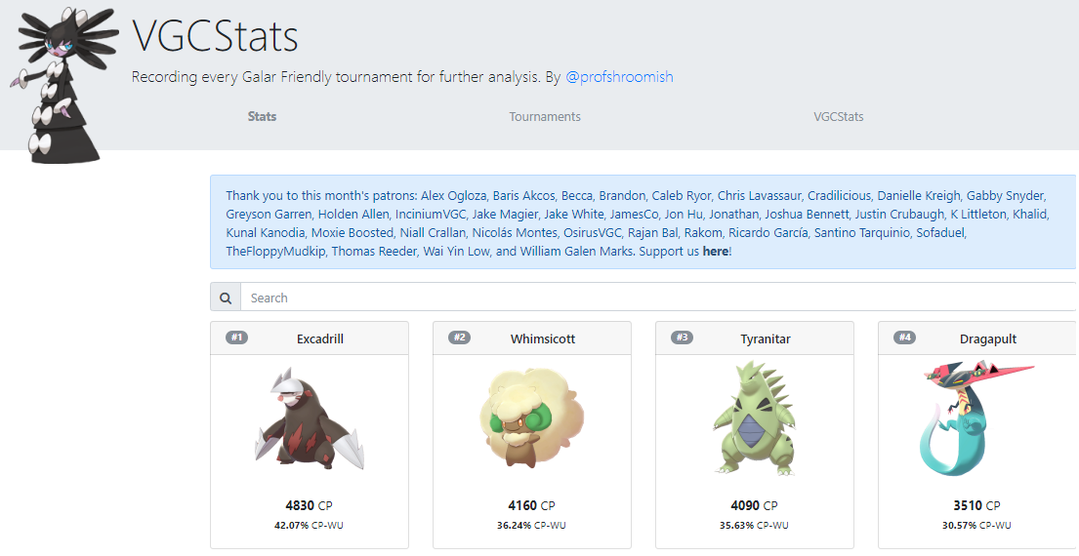
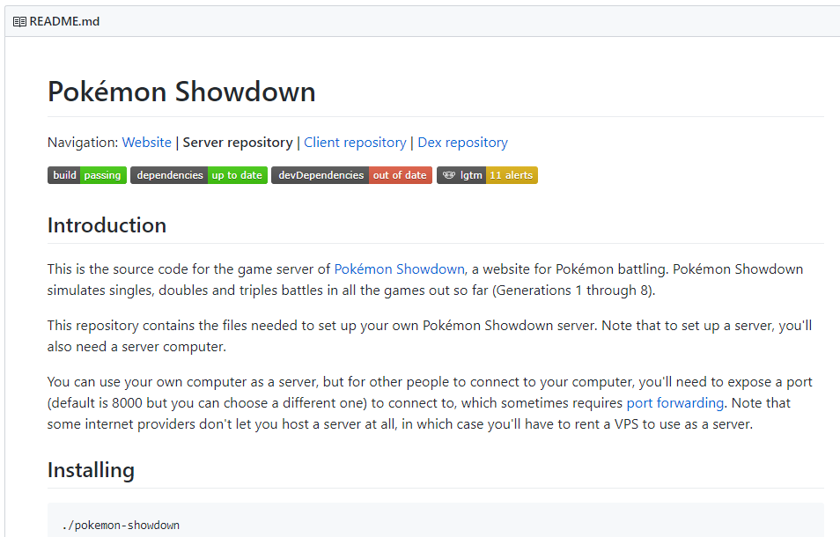

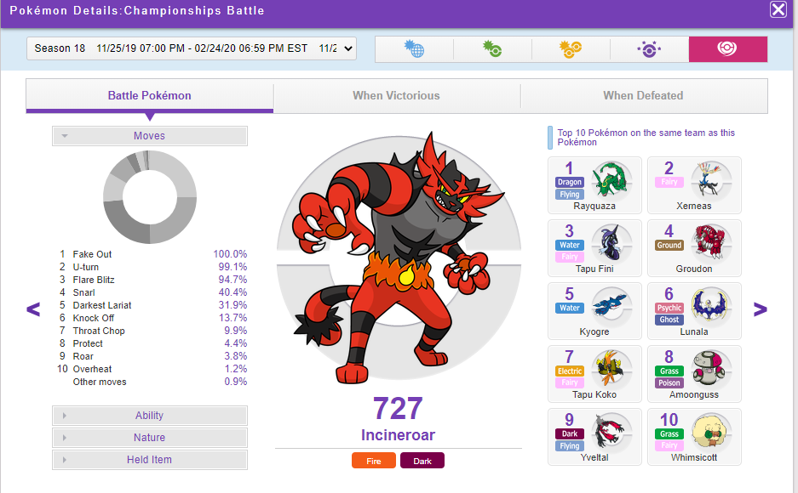
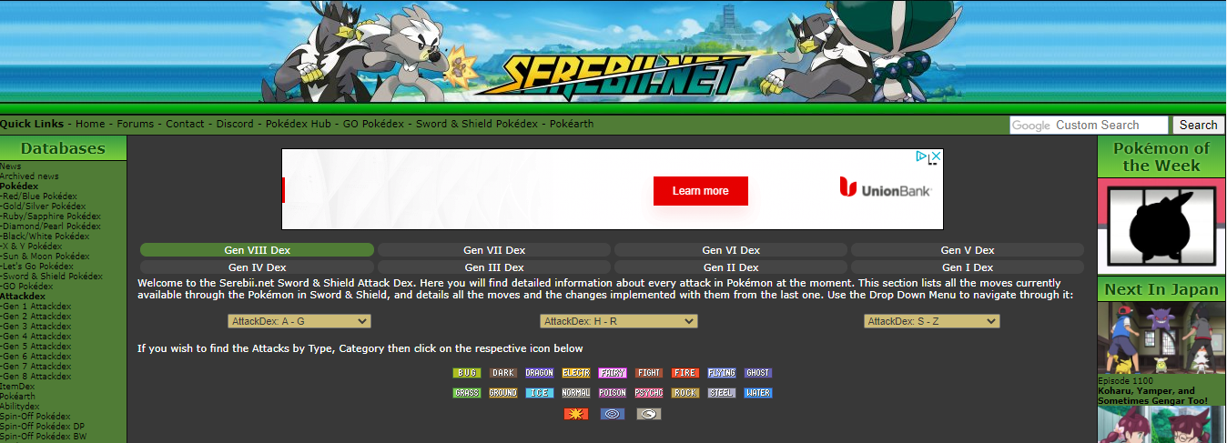
Data Sources
VGCStats
Fan-made website that tracks the current usage statistics of Pokémon used in the new generation
Smogon / Pokémon Showdown
Strategy site / Battle Simulator
Code available on GitHub
Official Pokémon Global Link Site
Stats on most commonly used Pokémon, their movesets, and Pokémon used to counter. (Not yet current with the new game’s stats)
Serebii.Net
Fan-made website that contains databases of all relevant Pokémon data (moves, types, abilities, etc.)

Slide 14
Conclusion / Questions

